Slide 1


SMART INDIA HACKATHON 2025
Bi-Mode Water Thermoregulator
Problem Statement ID – SIH1540
Problem Statement Title - Student Innovation
Theme - Smart Automation
PS Category - Hardware
Team ID - MITS/SIH/028
Team Name - HardTech Hub

Slide 2
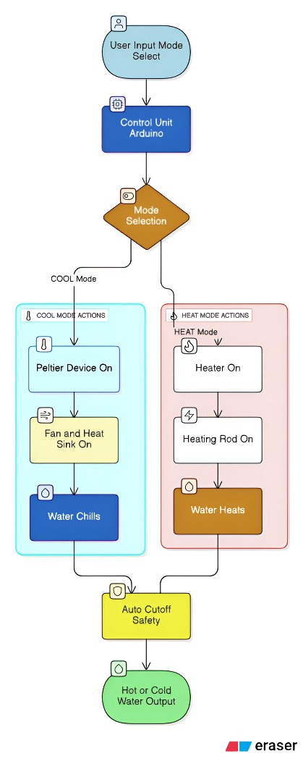
IDEA - Bi-Mode Water Thermoregulator
HardTech
HUB
MITS/SIH/028
Idea / Solution :-
All in-One Appliance: A single, portable device that delivers both hot and cold water.
Dual-Mode System:
  Cooling: Uses high-efficiency thermoelectric Peltier modules to chill water up to 5 to 15°C.
  Heating: Employs a nichrome heating element to warm water up to 50 to 60°C, ideal
  for beverages.
Smart Control: An Arduino Nano microcontroller monitors water temperature and provides
automatic power cut-off for safety and energy conservation.
How it Addresses the Problem Innovation and Uniqueness
Replaces Two Appliances: Eliminates the need Seamless Integration: The core innovation is
for a separate water heater and a refrigerator combining effective heating and cooling into
Saves Space & Energy: The compact design saves one portable unit.
significant space and reduces overall electricity True Thermoregulator: Unlike single-function
consumption. devices, our solution actively regulates water
Lowers Financial Barrier: Provides an affordable temperature up or down.
solution for target users like students, travelers, In essence, “our product is unique because,
and small households. unlike existing devices that only heat or cool, it combines both functions in one portable, affordable, and energy-efficient unit.”

Slide 3
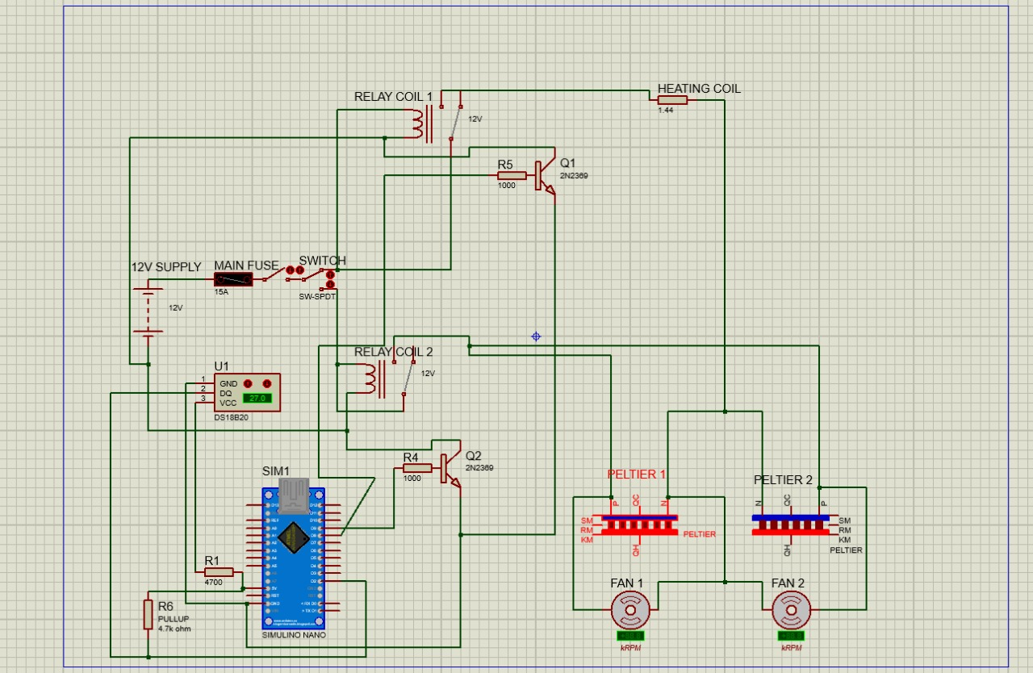
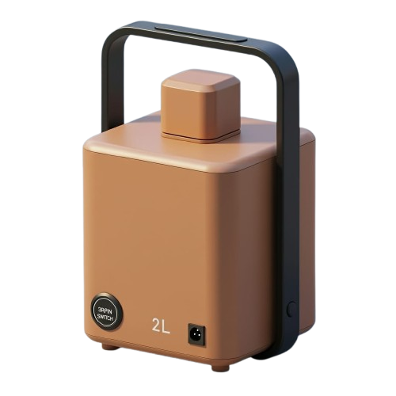
TECHNICAL APPROACH
HardTech
HUB
MITS/SIH/028
Technologies Used (Hardware):
2x Peltier TEC1-12706 Modules
Nichrome Resistance Heating Element
Arduino Nano Microcontroller
DS18B20 Waterproof Digital Sensor
12V 10A DC Power Supply, 12V Relay, SPDT Mode Switch
High-performance CPU Heatsink with a 12V DC Fan
In future, “the device can be integrated with a solar
panel and battery system for direct renewable panel
generation, making it fully sustainable.”
, Methodology and Implementation Process: Fig : 1.1 Circuit Diagram
In COOL mode, the relay powers the Peltier modules until water reaches 15°C, then turns off
In HEAT mode, the relay powers the Nichrome heater until water reaches 60°C, then turns off.
The Arduino continuously monitors the temperature to maintain it within the desired range.
  .

Slide 4
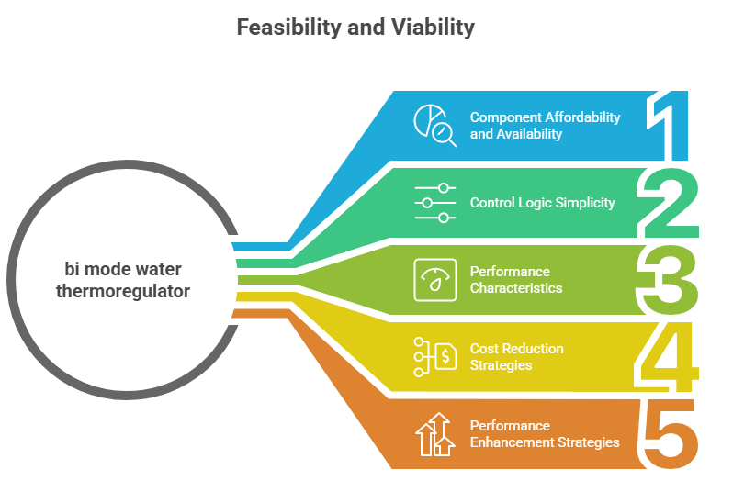
FEASIBILITY AND VIABILITY
HardTech
HUB
MITS/SIH/028
Components are affordable, widely available, and use proven engineering principles (Peltier effect and Joule heating).
Prototype cost is under ₹3000, with substantial cost reduction possible through bulk production.
Straight forward control logic enables reliable temperature management without complex circuitry.
Gradual cooling (10-15 mins for 2L) ensures stability, with efficient heat dissipation for better performance.
Strategies include improved heatsink design, better thermal
contact surfaces, insulation, and bulk sourcing to keep costs low.
“Market research shows no existing product offers both heating and cooling; available devices perform only one function or regulate temperature in a limited way.”

Slide 5
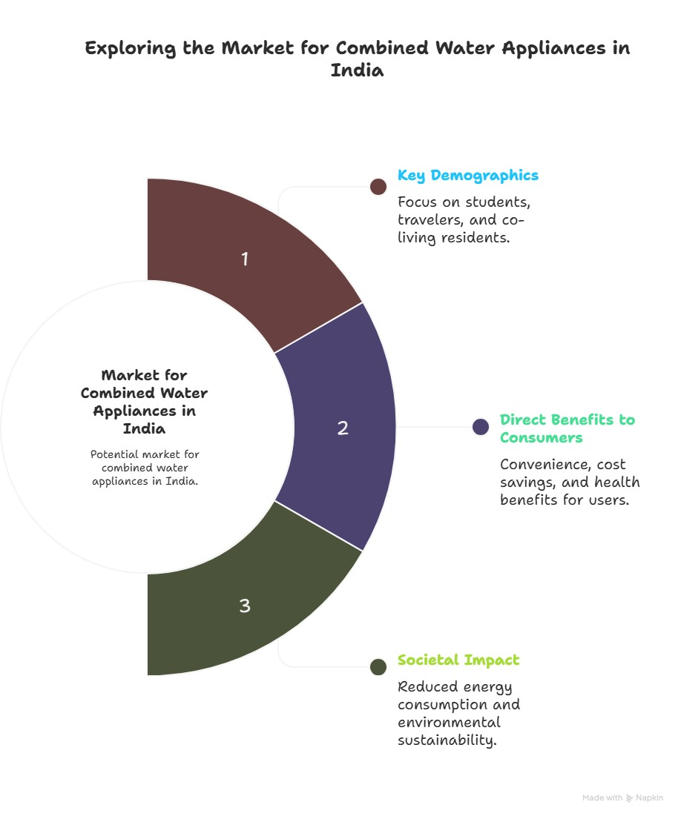
IMPACT AND BENEFITS
HardTech
HUB
MITS/SIH/028
Better living & convenience
Saves cost & energy
New affordable product
Eco-friendly, less
e-waste

Slide 6
RESEARCH AND REFERENCES
HardTech
HUB
MITS/SIH/028
Thermoelectric Cooling & Heating Principles.
Focus: D. M. Rowe (ed.), CRC Handbook of Thermoelectrics – a gold standard for understanding the Peltier effect and thermoelectric modules.
Investigation and marketing research of the Simultaneous Cooling and Heating.
Focus: Development of a sustainable, compact water refrigeration system using Peltier elements, suitable for domestic use; discusses COP and future optimizations
Links - https://www.techsciresearch.com/report/india-water-cooler-market/4300.html?utm_s
Economic- effectiveness experimental case study for instant cooling of drinking-water using Peltier module
Focus: Evaluates cost-effectiveness of instant water cooling via Peltier modules under various conditions using economic and thermodynamic analysis.
Link - https://www.futuremarketinsights.com/reports/thermoelectric-modules-market?utm_
Thermoelectric Generator Design and Characterization for Industrial Pipe Waste Heat Recovery
Focus: Thermal coupling, heat flow paths, trade-offs between module placement, thermal contact, Insights on system integration and characterization.
Link - https://www.mdpi.com/2227-9717/11/6/1714?utm_

